Slide 1
Imaging of Musculoskeletal system
Dr. Marwa majid al-adhab
Mbchb,fibms

Slide 2

Objectives
Radiographic anatomy of the bone
Imaging signs of bone disease
Imaging of osteomyelitis
Infection of the spine

Slide 3
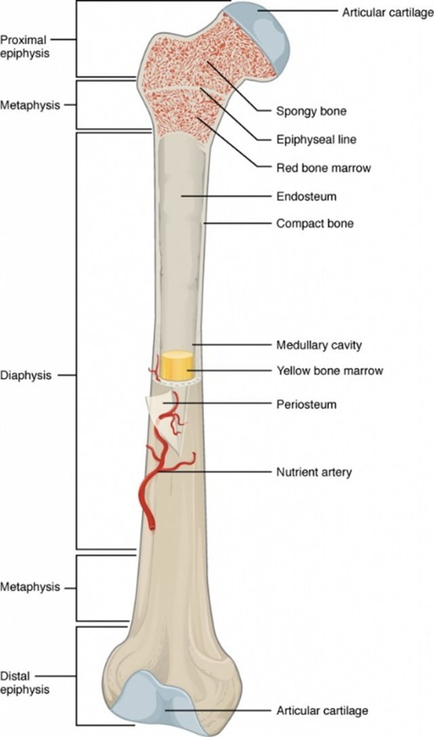
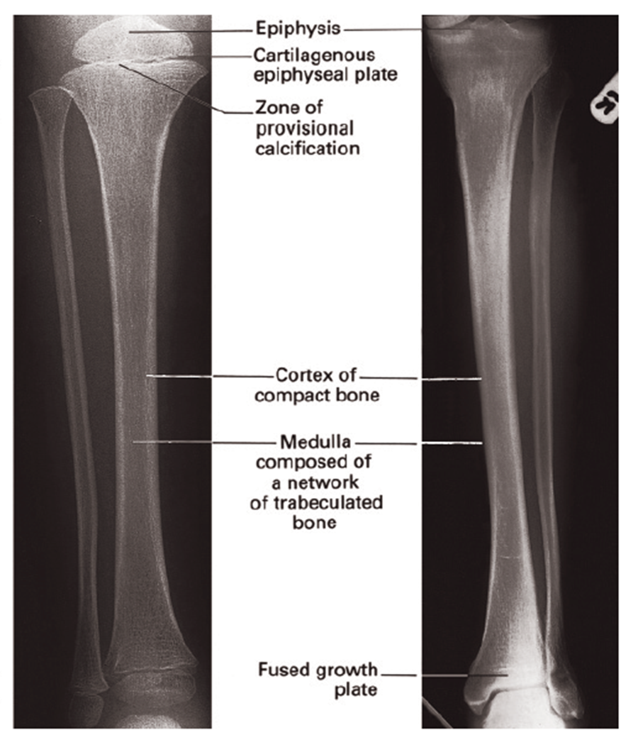

Slide 4
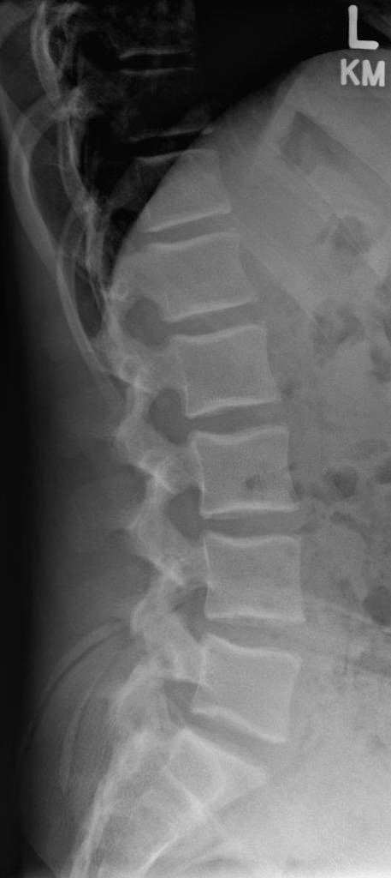
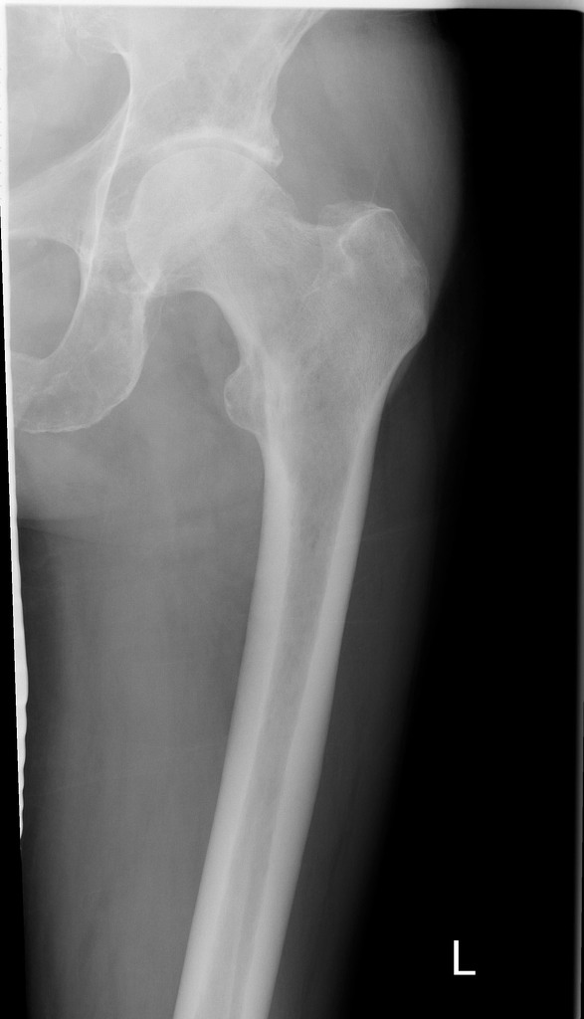
Normal radiographs

Slide 5
Imaging signs of bone disease
Decrease in bone density
Focal-----------lytic area
Generalized-----------osteopenia
increase in bone density
---------sclerosis

Slide 6
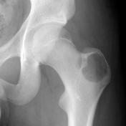
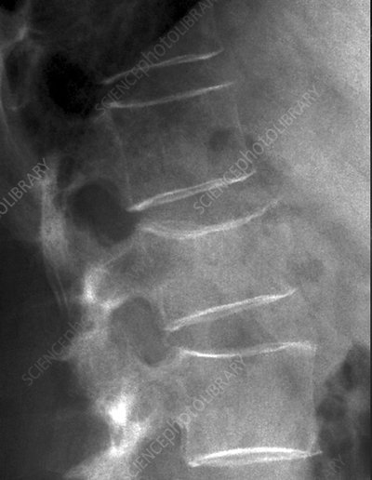

Slide 7
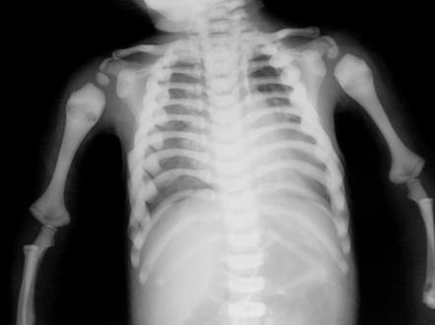
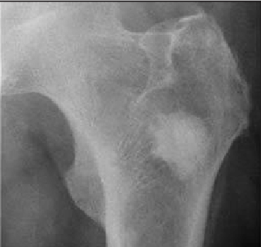

Slide 8
Periosteal reaction
Excess bone produced by the periosteum(appears as separate lines or spicules of calcification)
Types: Single lamellar
Spiculated
Onion skin
Codman’s triangle

Slide 9
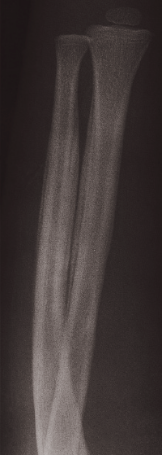
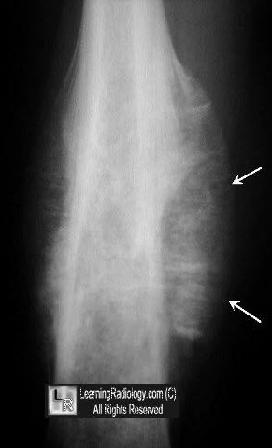
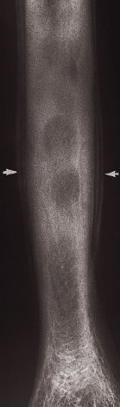
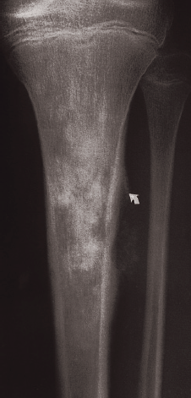
Solid lamellar Spiculated Onion skin Codman's triangle

Slide 10
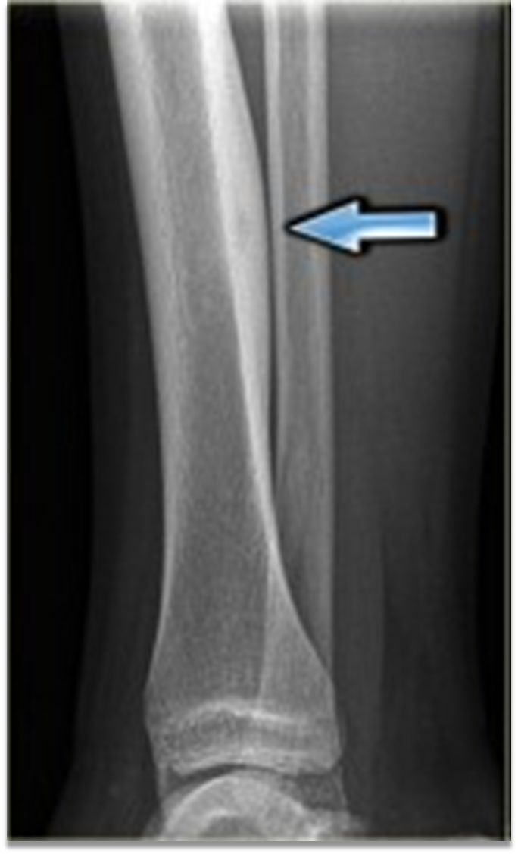
Cortical thickening
Also involve lying down of new bone by periosteum but the process is very slow or has healed → the new bone shows the same homogenous density as does the cortex

Slide 11
Alteration in trabecular pattern
Reduction in the number of trabeculae with an alteration in the remaining trabeculae
e.g. osteoporosis, Paget’s disease

Slide 12
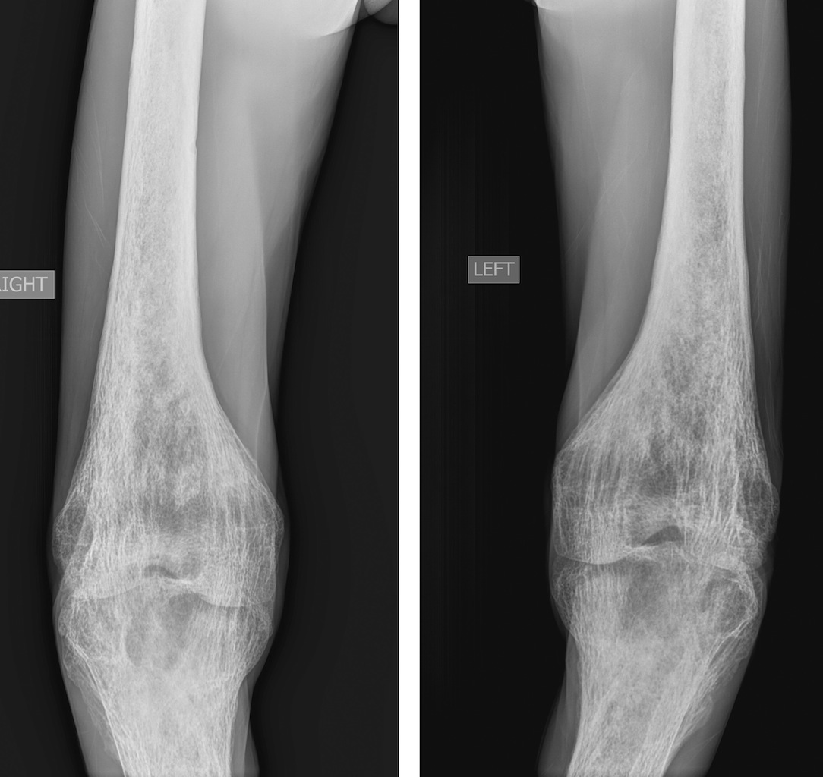
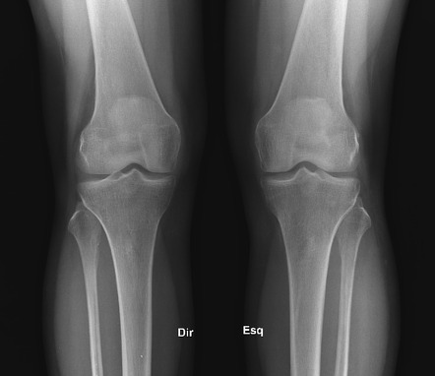

Slide 13
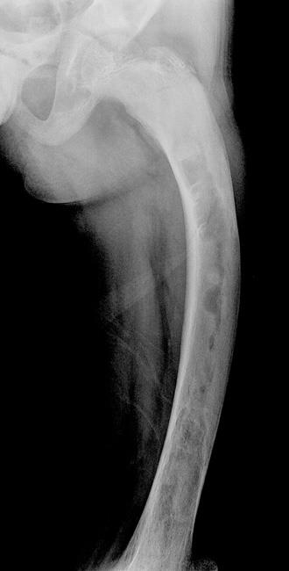
Alteration in the shape of a bone
is another complex response with many causes. Some are congenital in origin; some are acquired, e.g. acromegaly and expanding bone tumors.

Slide 14
Alteration in bone age
The time of appearance of the various epiphyseal centers and their time of fusion depends on the age of the child.
So, x ray can be used to detect discrepancy between chronological age and biological age.

Slide 15
Osteomyelitis
Definition: infection of the bone
Sources of invading organisms:
Hematogenous spread from distant foci
Contiguous source of infection (from an infected wound or from an infected adjacent joint)
Direct implantation (trauma or surgery)

Slide 16
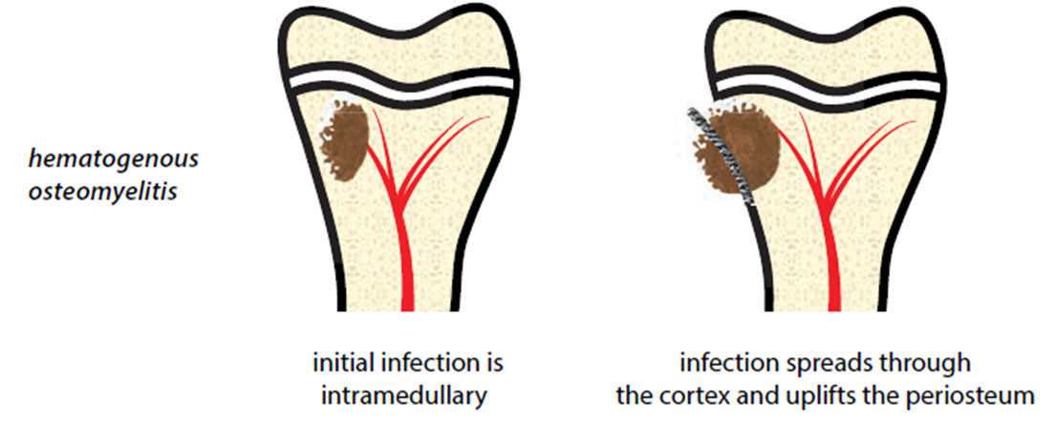
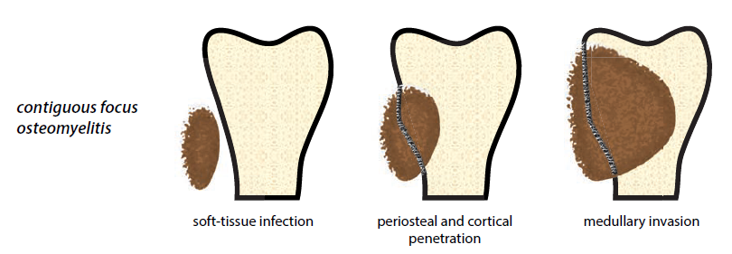

Slide 17
Osteomyelitis(continue)
Stages of osteomyelitis:
*Acute * Subacute *Chronic
Causative organism:
Most commonly pyogenic (bacterial) usually streptococcus in infants and staphylococcus in adults.
Other non pyogenic causes e.g. T.B , syphilis ,fungi

Slide 18
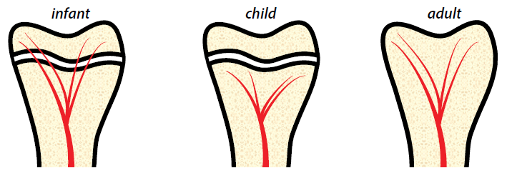
Direction of blood vessels

Slide 19
Osteomyelitis(continue)
Location of osteomyelitis within the bone:
Infants : metaphysis and/or epiphysis (acute pyogenic arthritis is a relatively common sequel of osteomyelitis)
Children(1-16yr): metaphysis (epiphysis and joint less frequently infected)
Adults: metaphysis and epiphysis

Slide 20
Imaging modalities
Plain x ray
Radionuclide bone scan
Mri
Ultrasound
Ct scan
Note: thorough clinical examination and laboratory investigations are extremely important in diagnosis, before imaging evaluation is performed.
Notes:
For management purposes the diagnosis is a clinical one – it should not be delayed by imaging

Slide 21
Radiological features on X ray
Soft-tissue changes: Swelling, with edema and blurring of fat planes.
(may be immediately apparent especially in infants)
Bone destruction: may be visualized within 10 to14 days of onset of symptoms. In children this is usually metaphyseal.

Slide 22
Radiological features (cont.)
Periosteal reaction : may become very extensive and surround the bone to form Involucrum which is usually visualized after 3 weeks and is more prolific in infants and children than in adults
Sequestrum: separate dense fragment formed due to death of part of original bone (As sequestra are devitalized they remain denser than surrounding vital bone, which becomes demineralized due to hyperaemia and immobilization).
Notes:
thin, thick or laminated (‘onion peel’) appearance (it can also have a ‘fluffy’ margin)▶ a Codman’s triangle may also be present

Slide 23
Radiological features (cont.)
In areas of dead periosteum, defects in the involucrum occur (cloacae), these allow pus and sequestra to escape, sometimes to the skin via a sinus.
Sinus tract: opening from the infection to the skin surface.

Slide 24
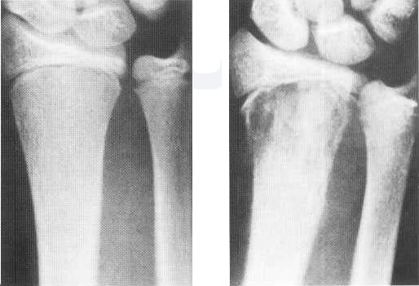
(A)Early metaphyseal infection. There is very minimal focal bone destruction at the distal radial metaphysis.
(B) With progressive destruction, metaphyseal abnormality is now very evident
A
B

Slide 25
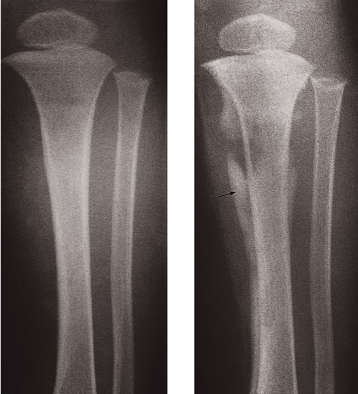
Osteomyelitis. (a) Initial films reveal no abnormality.
(b) Films taken 3 weeks later show some destruction of the upper end of the tibia and an extensive periosteal reaction along the tibia, particularly the medial side (arrow).
A
B

Slide 26
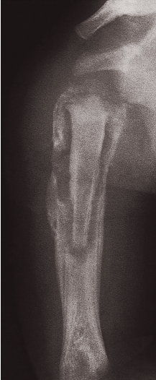
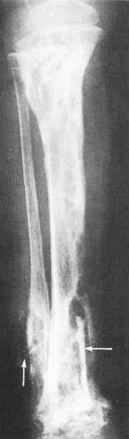
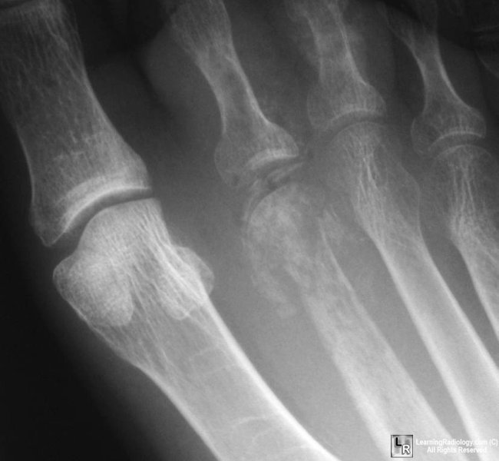

Slide 27
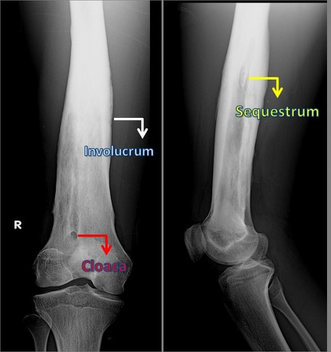

Slide 28
Radionuclide bone scan
Use ^{99m}Tc MDP (methylene diphosphonate)
3 phases scan: blood flow, blood pool, delayed scan
On osteomyelitis there is increase uptake on all phases
Changes appear much earlier in the course of the disease within a day or two

Slide 29
MRI
MRI: demonstrate osteomyelitis as early as isotope scanning and it’s the method of choice to diagnose musculoskeletal infection
Demonstrate edema in cortex, medulla, lack of enhancement in area of destruction and necrosis, soft tissue extension and pus accumulation in the bone and soft tissues
MR is much better at demonstrating the extent of pathology in bone and surrounding soft tissues

Slide 30
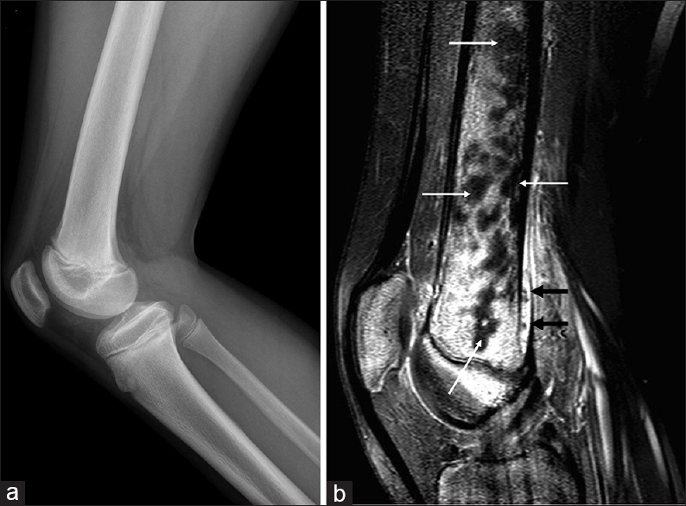
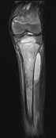

Slide 31
US and CT scan
Ultrasound: can demonstrate subperiosteal collections of pus well before bone changes are evident on plain film.
CT: demonstrate changes related to cortical bone or periosteum. Sequestra are shown as area of high attenuation spicules of bone within area of osteolysis. Cloaca, periosteitis and soft tissue lesions are also shown, Ct guided biopsy can be obtained for culture.

Slide 32
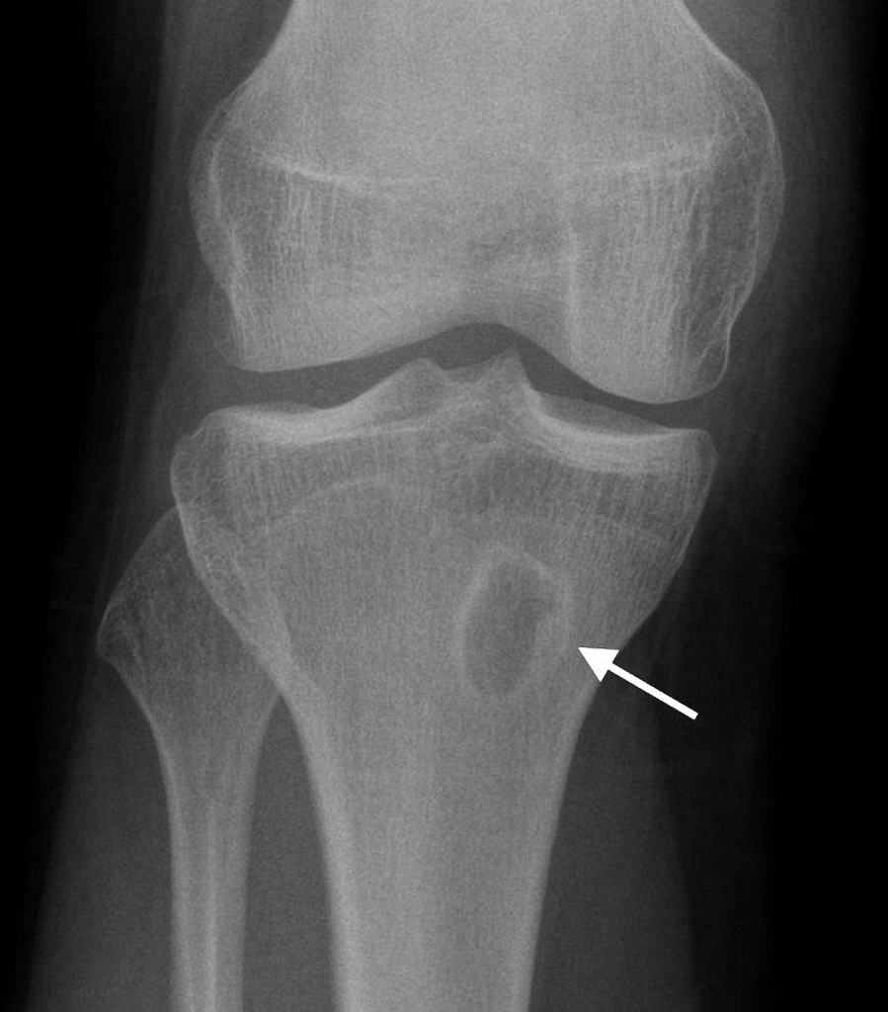
Sub acute osteomyelitis
Brodie abscess is a characteristic lesion of sub acute osteomyelitis, consisting of well-circumscribed area of bone destruction has a surrounding zone of reactive sclerosis
It may have a finger-like extension into neighboring bone toward the physeal plate, which, when present, is pathognomonic of infection

Slide 33
Chronic osteomyelitis
It is an indolent infection lasting greater than 6 weeks
It is a result of osteonecrosis caused by disruption of intraosseous and periosteal blood supply during the acute stage of the disease → sequestrum.
Infective agents within the devascularised sequestrum become protected from antibiotics and the endogenous immune response, forming a nidus for chronic infection.
This may persist for years

Slide 34
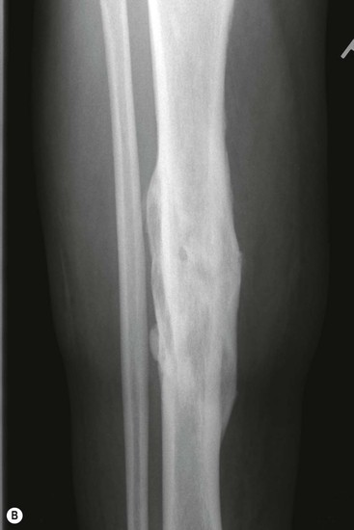
Chronic osteomyelitis(cont.)
Chronic osteomyelitis can cause a mixed lytic and sclerotic appearance, with a thickened cortex on plain radiograph
CT may provide information regarding the presence of sequestra, cloaca, cortical destruction and the thickness of the involucrum
Notes:
Chronic osteomyelitis of the tibia. There is cortical thickening and chronic periosteal new bone formation, forming an involucrum around an indistinct medullary cavity. There is a cloaca.

Slide 35
Distinction of neoplasm from osteomyelitis
The clinical history is clearly important. With malignant bone tumors, the radiographs are usually abnormal when the patient first presents, whereas with osteomyelitis the initial films are often normal.
Fat planes are often blurred in osteomyelitis while fat planes in neoplasm are displaced but preserved.
Chronic osteomyelitis may simulate a benign bone tumor on imaging examinations but the presence of fever, and sometimes of discharging sinuses, usually helps to diagnose an infective lesion.
It is not always possible using imaging tests to distinguish osteomyelitis from a bone tumor and biopsy is then needed.

Slide 36
Infection of the Spine
The hallmark of infection is destruction of the intervertebral disc and adjacent vertebral bodies.
Radiographic features:
Early in the course of the disease, there is narrowing of the disc space with end plates irregularities and erosion of the adjoining surface of the vertebral body.
Later, bone destruction may lead to collapse of the vertebral body, resulting in a sharp angulation known as a gibbus. A paravertebral abscess is usually present.

Slide 37
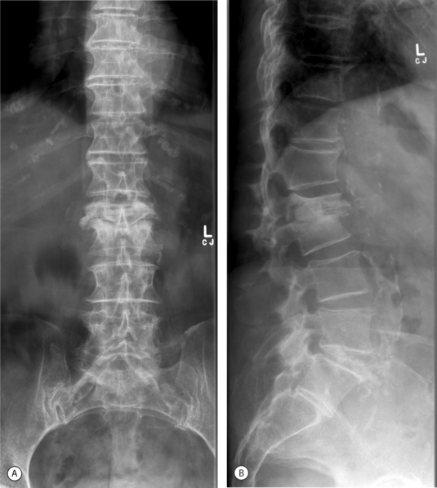
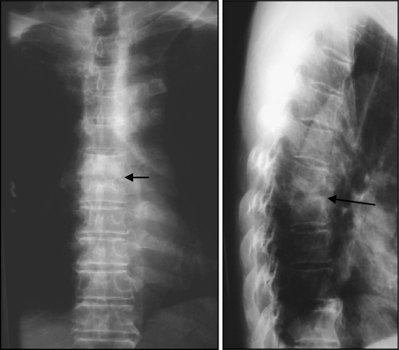

Slide 38
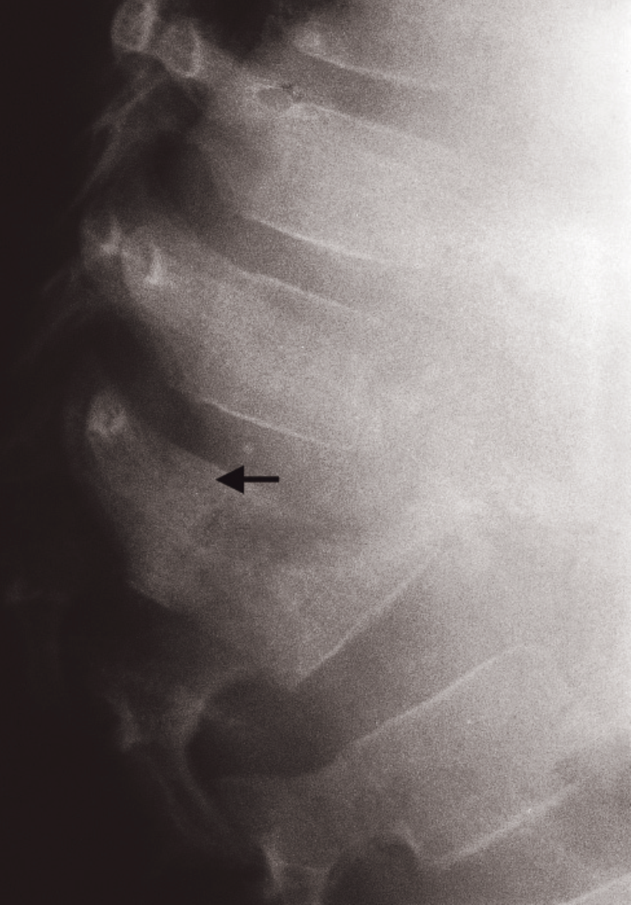
Plain film changes lag behind symptoms by 2-3 weeks.

Slide 39
Imaging of spinal infection(cont.)
CT scan
shows the bone destruction and paravertebral soft tissue swelling to advantage and disc space narrowing can be shown with sagittal reconstructions.
MRI
Is the preferred investigation as it can, with one examination, demonstrate disc space narrowing, altered signal in the adjacent vertebral body, adjacent soft tissue swelling and any spinal cord or nerve root compression

Slide 40
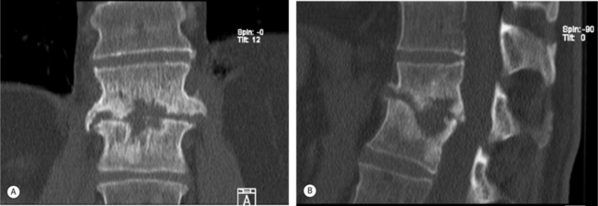
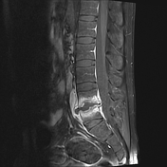
Common infecting organisms are Mycobacterium tuberculosis and Staphylococcus aureus.

Slide 41
Patients with spinal osteomyelitis often have a history of skin or pelvic infections. Spread of infection is usually to the vertebral body rather than to appendages and is mainly blood-borne, though osteomyelitis may follow spinal surgery.
Spread of disease from the pelvis is facilitated through Batson's vertebral venous plexus which is a valveless system of veins joining the pelvis with the rest of the axial skeleton via the spinal canal
The common infecting organisms are Mycobacterium tuberculosis and Staphylococcus aureus.

Slide 42
Though there are some differences in the signs produced by these two infections, there is considerable overlap
Variable
Pyogenic spondylitis
Tuberculous spondylitis
Commonly involved region
Involvements of vertebral bodies
Degree of disc preservation
Bony destruction
Para spinal abscess
Abscess wall
Calcification in abscess
Sclerosis
Lumber spine
≤ 2 vertebral bodies
Moderate to complete disc destruction
Mild to moderate
Less frequent
Thick and irregular
Absent
Sclerosis usually present
Thoracic spine
Multiple levels
Mild disc destruction
More severe
More and larger
Thin and smooth
Present
Lesion usually lytic

Slide 43
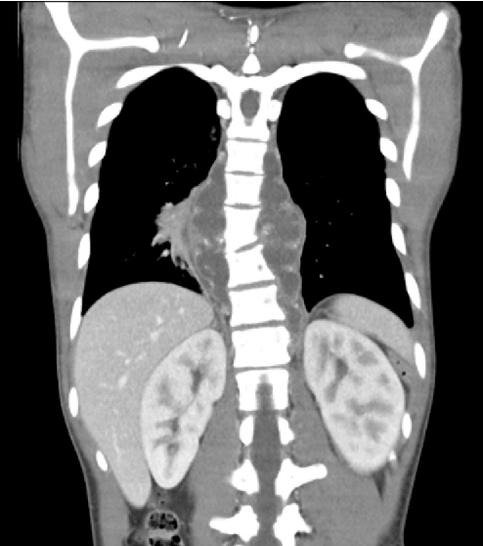
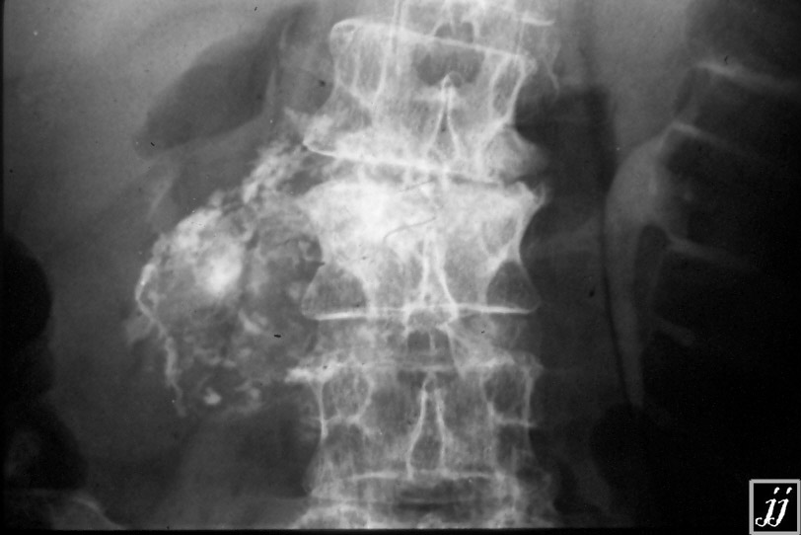

Slide 44



